Slide 1
Chapter 2
Physical Layer and Media

Slide 2
Objectives
discusses the relationship between data, which are created by a device, and electromagnetic signals, which are transmitted over a medium.
digital transmission. We discuss how we can covert digital or analog data to digital signals.
analog transmission. We discuss how we can covert digital or analog data to analog signals.
how we can use the available bandwidth efficiently. We discuss two separate, but related topics, multiplexing and spreading.
characteristics of transmission media, both guided and unguided, in this chapter. Although transmission media operates under the physical layer, they are controlled by the physical layer.

Slide 3
Physical Layer
interacts with the transmission media, the physical part of the network that connects network components together.
One of the services provided by the physical layer is to create a signal that represents this stream of bits.
The physical layer must also take care of the physical network, the transmission medium.
The transmission medium must be controlled by the physical layer. The physical layer decides on the directions of data flow. The physical layer decides on the number of logical channels for transporting data coming from different sources.

Slide 4

Note
To be transmitted, data must be transformed to electromagnetic signals.

Slide 5
3-1 ANALOG AND DIGITAL
Data can be analog or digital. The term analog data refers to information that is continuous; digital data refers to information that has discrete states. Analog data take on continuous values. Digital data take on discrete values.
Topics discussed in this section:
Analog and Digital Data
Analog and Digital Signals
Periodic and Nonperiodic Signals

Slide 6
Analog and Digital Data
Data can be analog or digital.
Analog data are continuous and take continuous values.
Digital data have discrete states and take discrete values.
Notes:
an analog clock that has hour, minute, and second hands gives information in a continuous form; the movements of the hands are continuous. On the other hand, a digital clock that reports the hours and the minutes will change suddenly from 8:05 to 8:06.

Slide 7
Analog and Digital Signals
Signals can be analog or digital.
Analog signals can have an infinite number of values in a range.
Digital signals can have only a limited number of values.

Slide 8
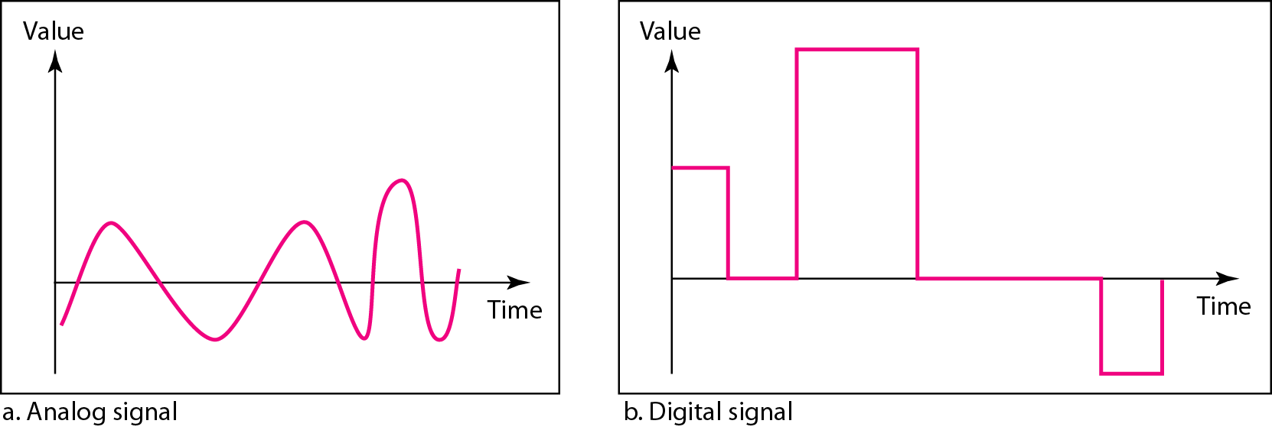
Figure 3.1 Comparison of analog and digital signals
Notes:
Figure illustrates an analog signal and a digital signal. The curve representing the analog signal passes through an infinite number of points. The vertical lines of the digital signal, however, demonstrate the sudden jump that the signal makes from value to value.

Slide 9
Periodic and Nonperiodic Signals
Both analog and digital signals can take one of two forms: periodic or nonperiodic
A periodic signal completes a pattern within a measurable time frame, called a period, and repeats that pattern over subsequent identical periods. The completion of one full pattern is called a cycle.
A nonperiodic signal changes without exhibiting a pattern or cycle that repeats over time.
Notes:
Both analog and digital signals can be periodic or nonperiodic. In data communications, we commonly use periodic analog signals (because they need less bandwidth, and nonperiodic digital signals (because they can represent variation in data)

Slide 10
3-2 PERIODIC ANALOG SIGNALS
In data communications, we commonly use periodic analog signals and nonperiodic digital signals.
Periodic analog signals can be classified as simple or composite. A simple periodic analog signal, a sine wave, cannot be decomposed into simpler signals. A composite periodic analog signal is composed of multiple sine waves.
Topics discussed in this section:
Sine Wave
Wavelength
Time and Frequency Domain
Composite Signals
Bandwidth
Notes:
Both analog and digital signals can be periodic or nonperiodic. In data communications, we commonly use periodic analog signals (because they need less bandwidth,as we will see in Chapter 5) and nonperiodic digital signals (because they can represent variation in data, as we will see in Chapter 6)

Slide 11
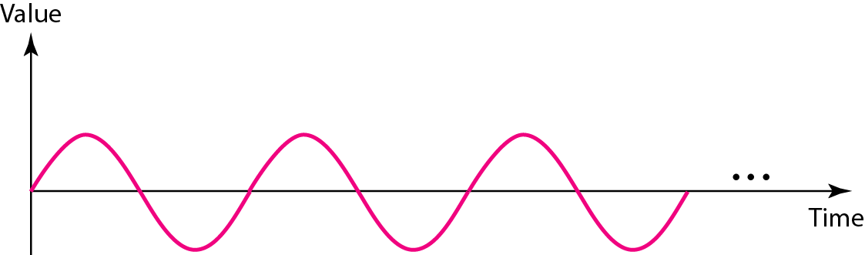
Figure 3.2 A sine wave
simple oscillating curve, its change over the course of a cycle is smooth and consistent, a continuous, rolling flow.
A sine wave can be represented by three parameters: the peak amplitude, the frequency, and the phase. These three parameters fully describe a sine wave.
periodic analog signal.

Slide 12
Signal characteristics
The peak amplitude
The peak amplitude of a signal is the absolute value of its highest intensity, proportional to the energy it carries. For electric signals, peak amplitude is normally measured in volts.

Slide 13
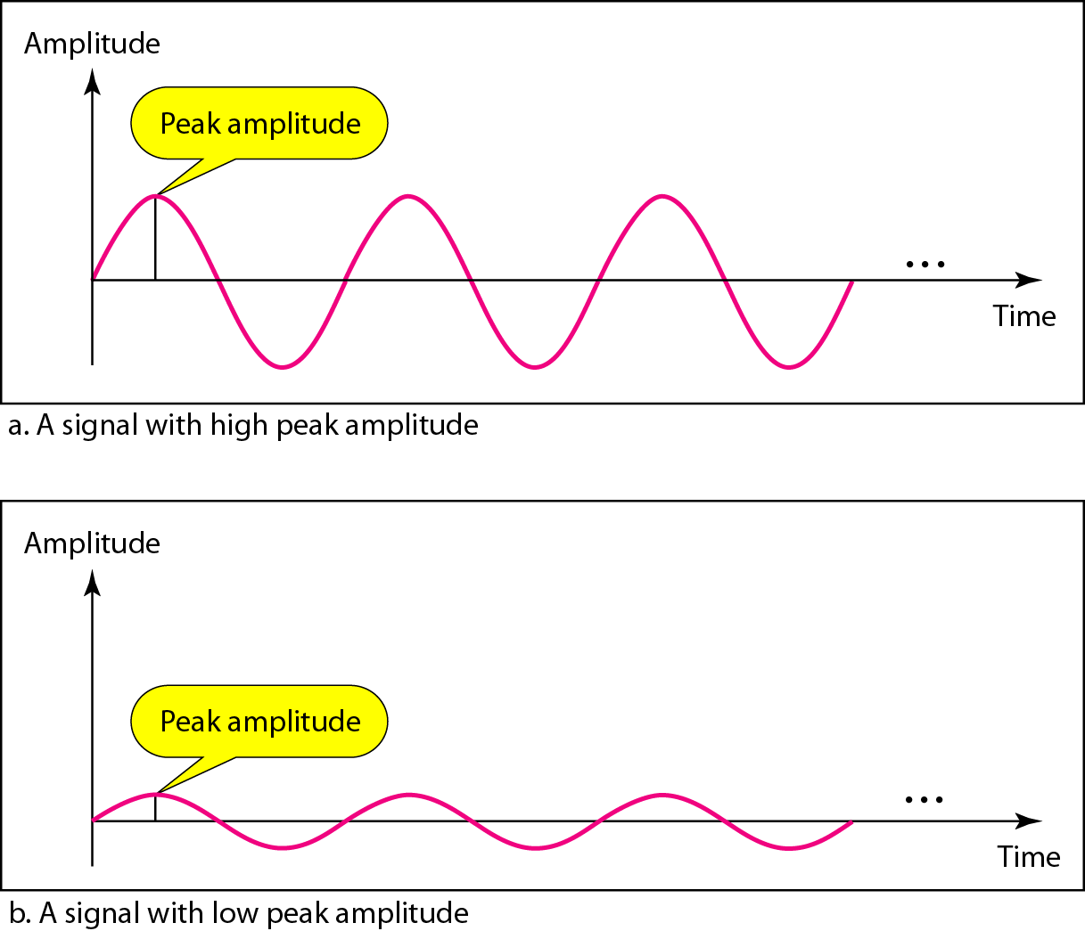
Figure 3.3 Two signals with the same phase and frequency, but different amplitudes
Notes:
The peak amplitude of a signal is the absolute value of its highest intensity, proportional to the energy it carries. For electric signals, peak amplitude is normally measured in volts.

Slide 14
Period and Frequency Period refers to the amount of time, in seconds, a signal needs to complete 1 cycle. Frequency refers to the number of periods in I s.
Notes:
Note that period and frequency are just one characteristic defined in two ways.

Slide 15

Note
Frequency and period are the inverse of each other.
Notes:
Period refers to the amount of time, in seconds, a signal needs to complete 1 cycle. Frequency refers to the number of periods in 1 s. Note that period and frequency are just one characteristic defined in two ways.

Slide 16
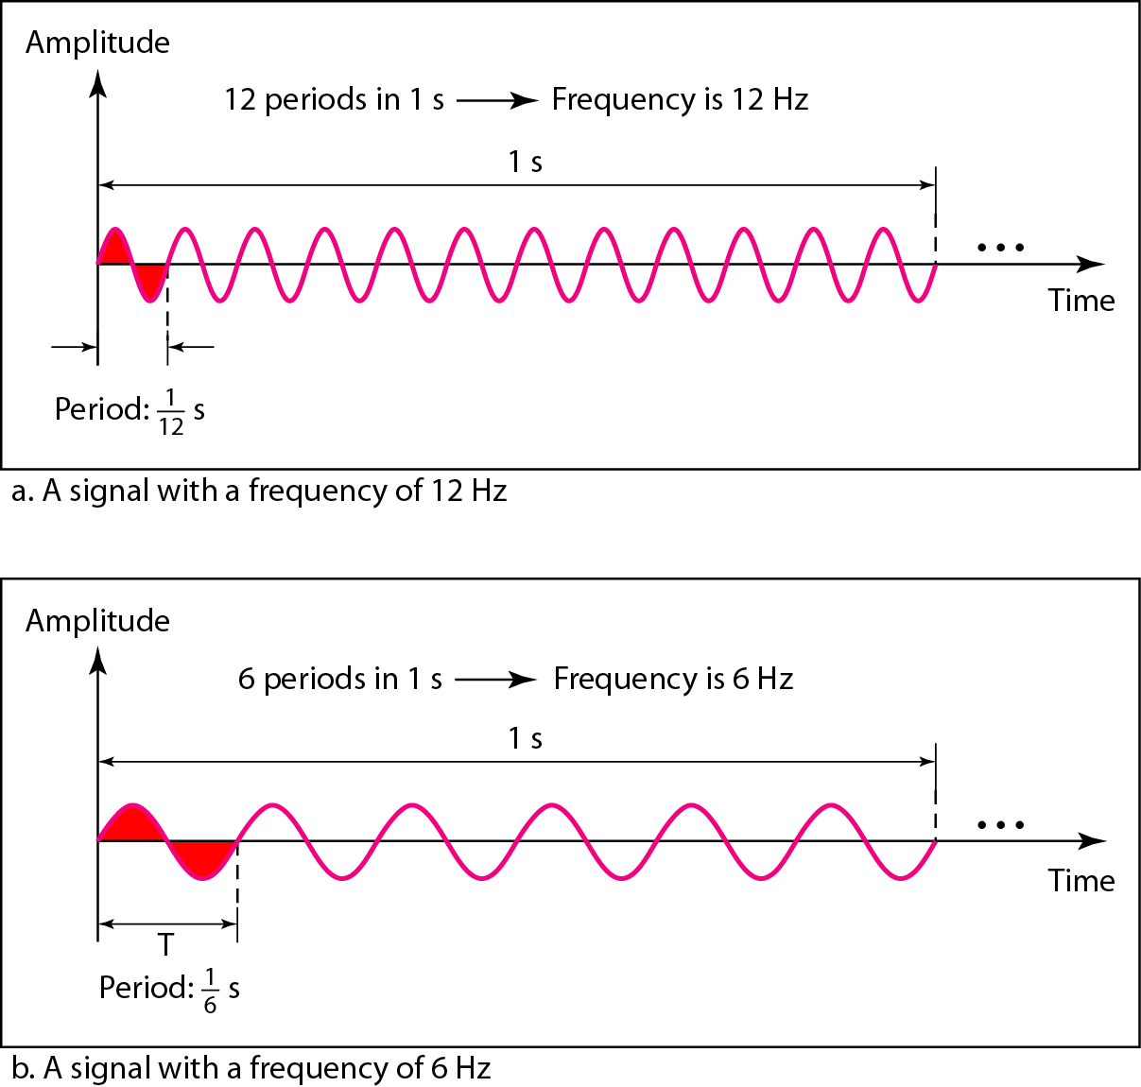
Figure 3.4 Two signals with the same amplitude and phase, but different frequencies
Notes:
Period is formally expressed in seconds. Frequency is formally expressed in Hertz (Hz), which is cycle per second.

Slide 17
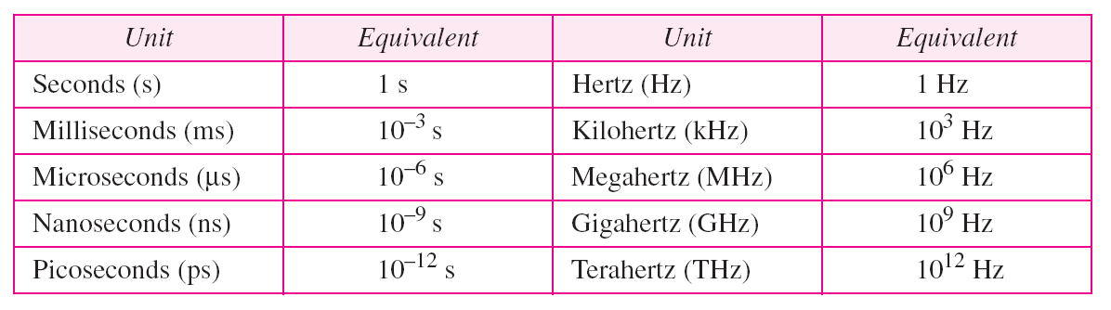
Period is formally expressed in seconds. Frequency is formally expressed in Hertz (Hz), which is cycle per second.
Table 3.1 Units of period and frequency

Slide 18
Frequency
Frequency is the rate of change with respect to time.
Change in a short span of time means high frequency.
Change over a long span of time means low frequency.

Slide 19
Note
If a signal does not change at all, its frequency is zero.
If a signal changes instantaneously, its frequency is infinite.
Notes:
Two Extremes What if a signal does not change at all? What if it maintains a constant voltage level for the entire time it is active? In such a case, its frequency is zero. Conceptually, this idea is a simple one. Ifa signal does not change at all, it never completes a cycle, so its frequency is aHz. But what if a signal changes instantaneously? What if it jumps from one level to another in no time? Then its frequency is infinite. In other words, when a signal changes instantaneously, its period is zero; since frequency is the inverse of period, in this case, the frequency is 1/0, or infinite (unbounded).

Slide 20
Note
Phase describes the position of the waveform relative to time 0.
Notes:
Phase is measured in degrees or radians [360° is 2n rad; 1° is 2n/360 rad, and 1 rad is 360/(2n)]. A phase shift of 360° corresponds to a shift of a complete period; a phase shift of 180° corresponds to a shift of one-half of a period; and a phase shift of 90° corresponds to a shift of one-quarter of a period

Slide 21
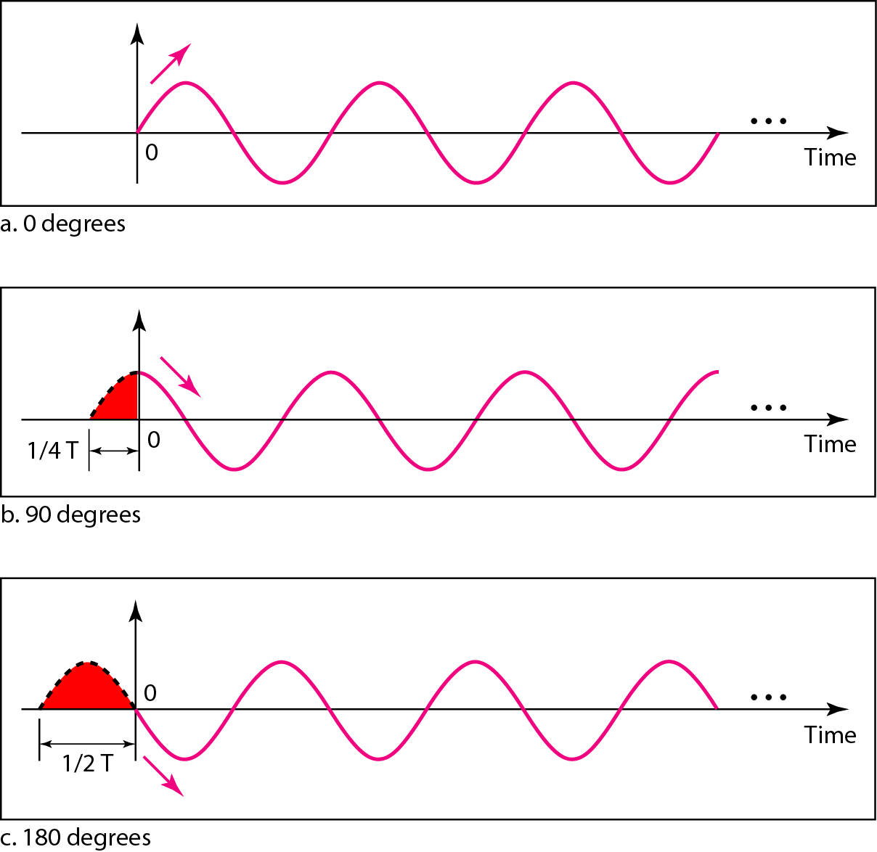
Figure 3.5 Three sine waves with the same amplitude and frequency, but different phases
Notes:
A sine wave with a phase of 0° starts at time 0 with a zero amplitude. The amplitude is increasing. 2. A sine wave with a phase of 90° starts at time 0 with a peak amplitude. The amplitude is decreasing. 3. A sine wave with a phase of 180° starts at time 0 with a zero amplitude. The amplitude is decreasing. Another way to look at the phase is in terms of shift or offset. We can say that 1. A sine wave with a phase of 0° is not shifted. 2. A sine wave with a phase of 90° is shifted to the left by ! cycle. However, note that the signal does not really exist before time O. 3. A sine wave with a phase of 180° is shifted to the left by ~ cycle. However, note that the signal does not really exist before time O.
Phase is measured in degrees or radians [360° is 2n rad; 1° is 2n/360 rad, and 1 rad is 360/(2n)]. A phase shift of 360° corresponds to a shift of a complete period; a phase shift of 180° corresponds to a shift of onehalf of a period; and a phase shift of 90° corresponds to a shift of one-quarter of a period.

Slide 22
Example 3.3
A sine wave is offset 1/6 cycle with respect to time 0. What is its phase in degrees and radians?
Solution
We know that 1 complete cycle is 360°. Therefore, 1/6 cycle is

Slide 23
Wavelength
Wavelength is a property of any type of signal.
The wavelength is the distance a simple signal can travel in one period.
Wavelength binds the period or the frequency of a simple sine wave to the propagation speed of the medium.
frequency of a signal is independent of the medium, the wavelength depends on both the frequency and the medium.
In data communications, we often use wavelength to describe the transmission of light in an optical fiber.

Slide 24
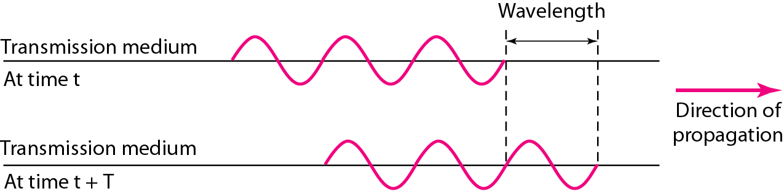
Figure 3.6 Wavelength and period

Slide 25

Wavelength can be calculated if one is given the propagation speed (the speed of light) and the period of the signal. However, since period and frequency are related to each other, if we represent wavelength by , propagation speed by c (speed of light), and frequency by f, we get . Wavelength =propagation speed x period of a signal = propagation speed /frequency
The propagation speed of electromagnetic signals depends on the medium and on the frequency of the signal.
For example, in a vacuum, light is propagated with a speed of 3 x 10⁸ mls. That speed is lower in air and even lower in cable. The wavelength is normally measured in micrometers (microns) instead of meters. For example, the wavelength of red light (frequency =4 x 10¹⁴) in air is
In a coaxial or fiber-optic cable, however, the wavelength is shorter because the propagation speed in the cable is decreased.

Slide 26
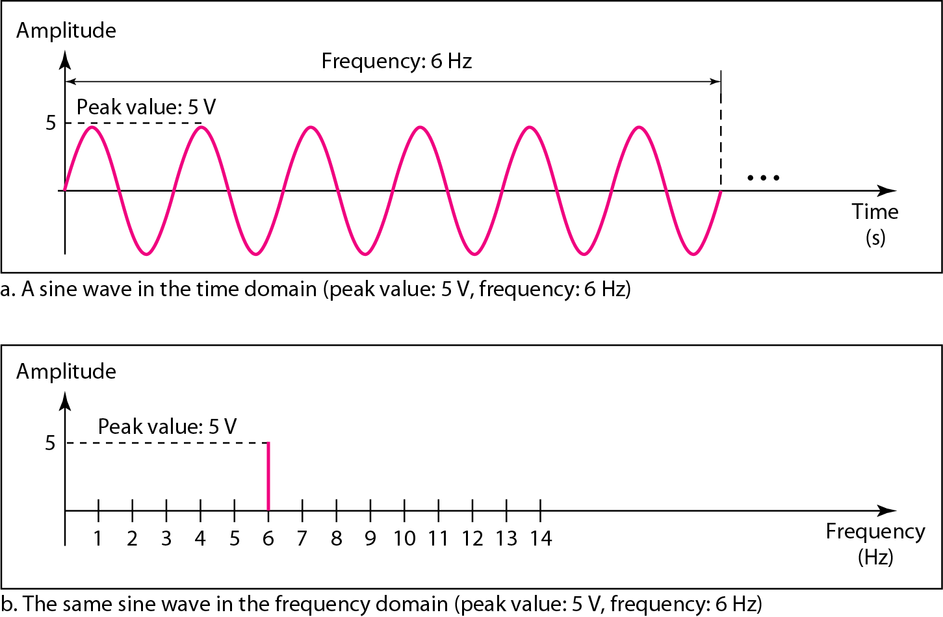
Figure 3.7 The time-domain and frequency-domain plots of a sine wave
Notes:
The time-domain plot
shows changes in signal amplitude with respect to time (it is an amplitude-versus-time plot). Phase is not explicitly shown on a time-domain plot. To show the relationship between amplitude and frequency, we can use what is called a frequency-domain plot.
A frequency-domain plot is concerned with only the peak value and the frequency. Changes of amplitude during one period are not shown. Figure 3.7 shows a signal in both the time and frequency domains.
It is obvious that the frequency domain is easy to plot and conveys the information that one can find in a time domain plot. The advantage of the frequency domain is that we can immediately see the values of the frequency and peak amplitude. A complete sine wave is represented by one spike. The position of the spike shows the frequency; its height shows the peak amplitude.

Slide 27
Note
A complete sine wave in the time domain can be represented by one single spike in the frequency domain.

Slide 28
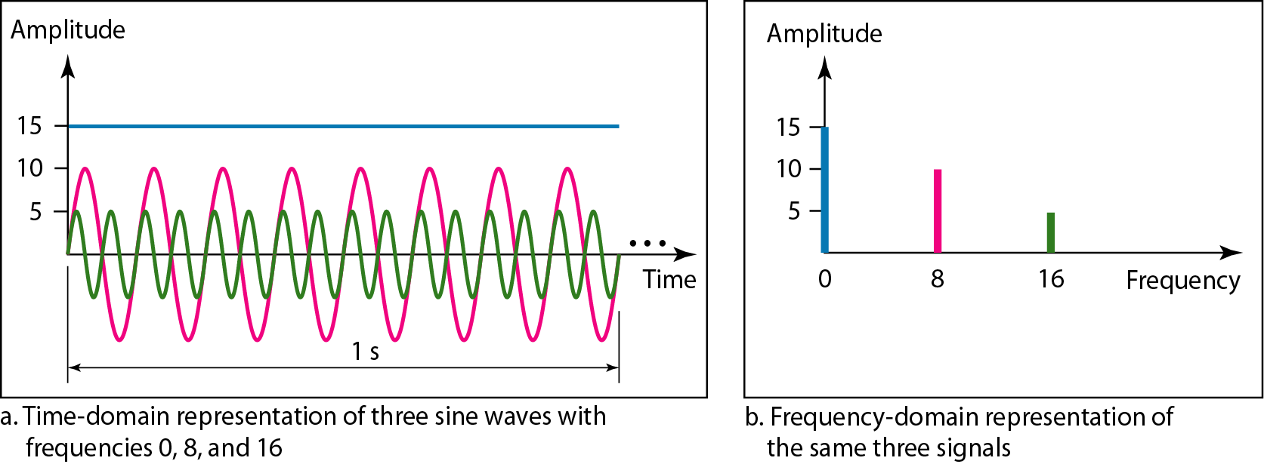
Figure 3.8 The time domain and frequency domain of three sine waves

Slide 29
Signals and Communication
A single-frequency sine wave is not useful in data communications
We need to send a composite signal, a signal made of many simple sine waves.
According to Fourier analysis, any composite signal is a combination of simple sine waves with different frequencies, amplitudes, and phases.
Notes:
Simple sine waves have many applications in daily life. We can send a single sine wave to carry electric energy from one place to another. For example, the power company sends a single sine wave with a frequency of 60 Hz to distribute electric energy to houses and businesses. As another example, we can use a single sine wave to send an alarm to a security center when a burglar opens a door or window in the house. In the first case, the sine wave is carrying energy; in the second, the sine wave is a signal of danger. If we had only one single sine wave to convey a conversation over the phone, it would make no sense and carry no information. We would just hear a buzz. As we will see in Chapters 4 and 5, we need to send a composite signal to communicate data. A composite signal is made of many simple sine waves.

Slide 30
Composite Signals and Periodicity
If the composite signal is periodic, the decomposition gives a series of signals with discrete frequencies.
If the composite signal is nonperiodic, the decomposition gives a combination of sine waves with continuous frequencies.

Slide 31
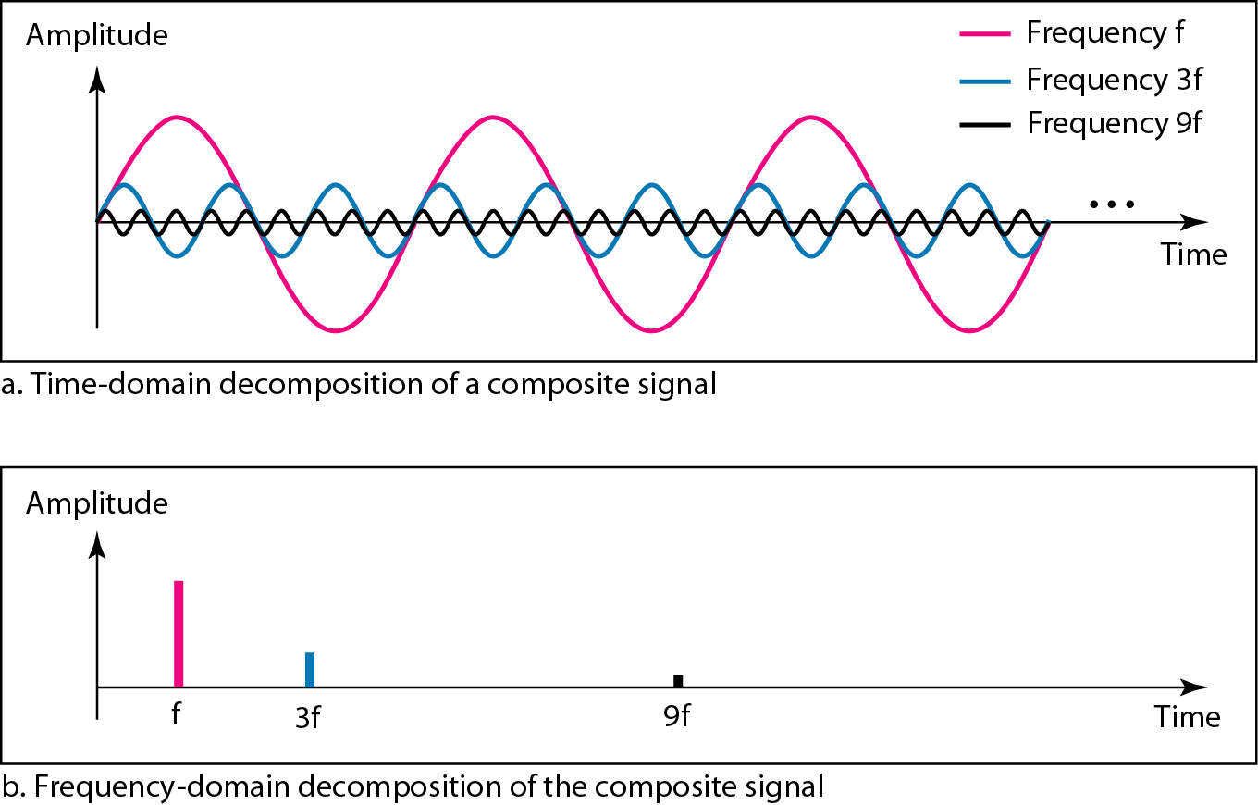
Figure 3.10 Decomposition of a composite periodic signal in the time and frequency domains

Slide 32
Bandwidth and Signal Frequency
The bandwidth of a composite signal is the difference between the highest and the lowest frequencies contained in that signal.

Slide 33
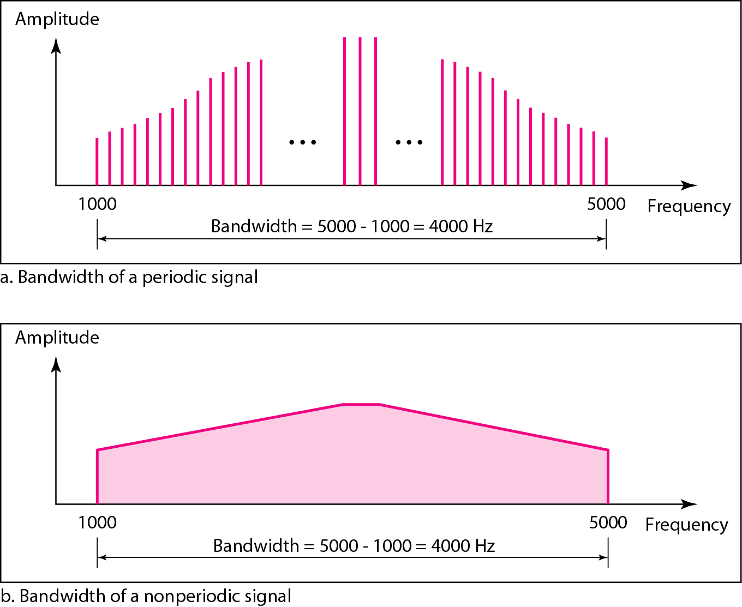
Figure 3.12 The bandwidth of periodic and nonperiodic composite signals

Slide 34
3-3 DIGITAL SIGNALS
In addition to being represented by an analog signal, information can also be represented by a digital signal. For example, a 1 can be encoded as a positive voltage and a 0 as zero voltage. A digital signal can have more than two levels. In this case, we can send more than 1 bit for each level.
Topics discussed in this section:
Bit Rate
Bit Length
Digital Signal as a Composite Analog Signal
Application Layer

Slide 35
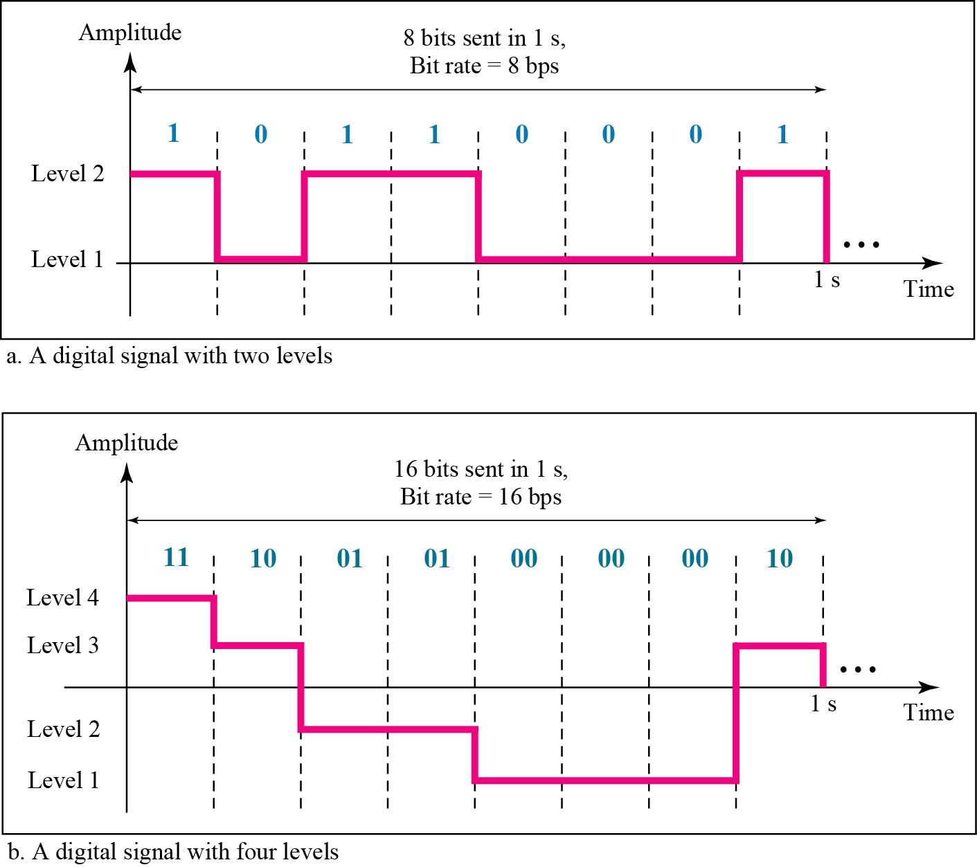
Figure 3.16 Two digital signals: one with two signal levels and the other with four signal levels

Slide 36
Bit Rate
Most digital signals are nonperiodic, and thus period and frequency are not appropriate characteristics. Another term-bit rate (instead of frequency)-is used to describe digital signals.
The bit rate is the number of bits sent in 1s, expressed in bits per second (bps). Figure 3.16 shows the bit rate for two signals.

Slide 37
Bit Length
We discussed the concept of the wavelength for an analog signal: the distance one cycle occupies on the transmission medium. We can define something similar for a digital signal: the bit length. The bit length is the distance one bit occupies on the transmission medium.
Bit length =propagation speed x bit duration

Slide 38
Bit Length
Data Rate Limits: one of the most important consideration in data communications is how fast we can send data, in bits per second over a channel. Data rate depends on three factors: a.The bandwidth available b.The level of the signals we use c.The quality of the channel (the level of noise)

Slide 39
3-4 TRANSMISSION IMPAIRMENT
Signals travel through transmission media, which are not perfect. The imperfection causes signal impairment. This means that the signal at the beginning of the medium is not the same as the signal at the end of the medium. What is sent is not what is received. Three causes of impairment are attenuation, distortion, and noise.
Topics discussed in this section:
Attenuation
Distortion
Noise

Slide 40
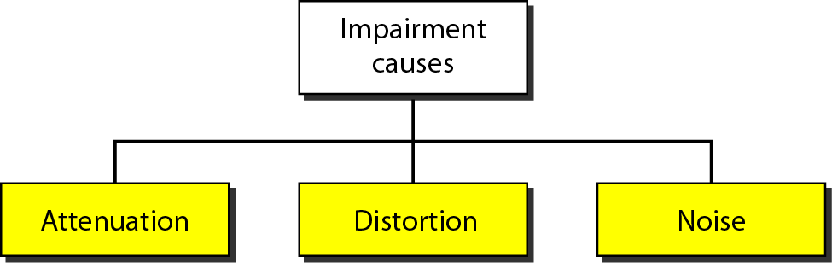
Figure 3.25 Causes of impairment

Slide 41
Attenuation
where signal strength falls off with distance
depends on medium
received signal strength must be:
strong enough to be detected
sufficiently higher than noise to receive without error
so increase strength using amplifiers/repeaters
is also an increasing function of frequency
so equalize attenuation across band of frequencies used
eg. using loading coils or amplifiers
Notes:
Attenuation Attenuation means a loss of energy. When a signal, simple or composite, travels through a medium, it loses some of its energy in overcoming the resistance of the medium. That is why a wire carrying electric signals gets warm, if not hot, after a while. Some of the electrical energy in the signal is converted to heat. To compensate for this loss, amplifiers are used to amplify the signal. Figure 3.26 shows the effect of attenuation and amplification.

Slide 42
Measurement of Attenuation
Attenuation is measured in terms of Decibels.
The decibel (dB) measures the relative strengths of two signals or one signal at two different points. Note that the decibel is negative if a signal is attenuated and positive if a signal is amplified.
dB = 10log₁₀P₂/P₁
P₁ - input signal
P₂ - output signal

Slide 43
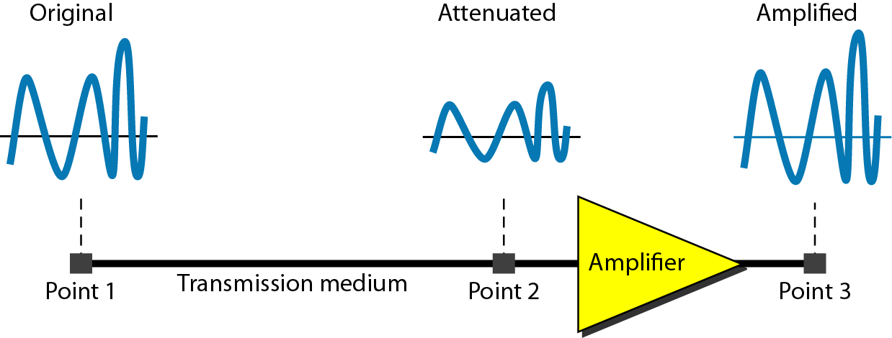
Figure 3.26 Attenuation

Slide 44
Distortion
Means that the signal changes its form or shape
Distortion can occur in a composite signal made of different frequencies.
Each frequency component has its own propagation speed traveling through a medium.
The different components therefore arrive with different delays at the receiver.
That means that the signals have different phases at the receiver than they did at the source.
Notes:
Each signal component has its own propagation speed through a medium and, therefore, its own delay in arriving at the final destination. Differences in delay may create a difference in phase if the delay is not exactly the same as the period duration. In other words, signal components at the receiver have phases different from what they had at the sender.The shape of the composite signal is therefore not the same.

Slide 45
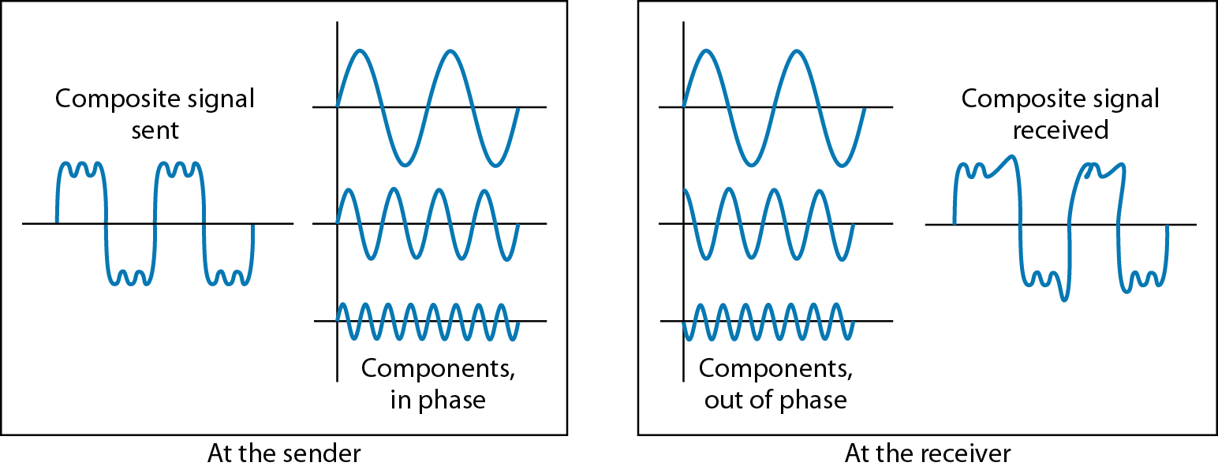
Figure 3.28 Distortion

Slide 46
Noise
Noise is any unwanted signal that is mixed or combined with the original signal during transmission.
Due to noise the original signal is altered and signal received is not same as the one sent.

Slide 47
Noise
There are different types of noise
Thermal - is the random motion of electrons in a wire which creates an extra signal not originally sent by the transmitter.
Induced – Induced noise comes from sources such as motors and appliances. These devices act as a sending antenna, and the transmission medium acts as the receiving antenna. .
Crosstalk - Crosstalk is the effect of on the other. One wire acts as a sending antenna and the other as the receiving antenna.
Impulse - Impulse noise is a spike (a signal with high energy in a very short time) that comes from power lines, lightning, and so on.

Slide 48
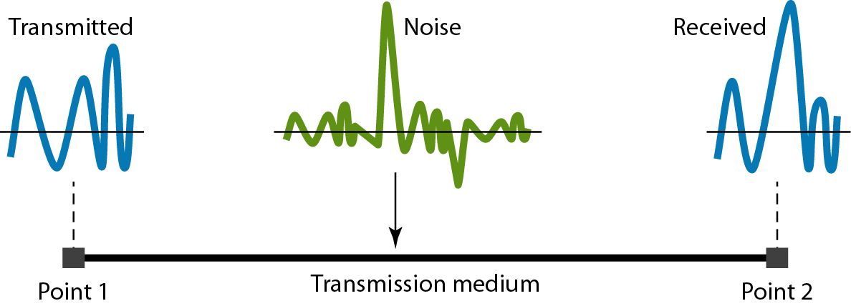
Figure 3.29 Noise

Slide 49
Signal to Noise Ratio (SNR)
To measure the quality of a system the SNR is often used. It indicates the strength of the signal wrt the noise power in the system.
SNR= Average Signal power / Average Noise Power
It is the ratio between two powers.
It is usually given in dB and referred to as SNR_{dB.} defined as SNRdB = l0logl0 SNR

Slide 50
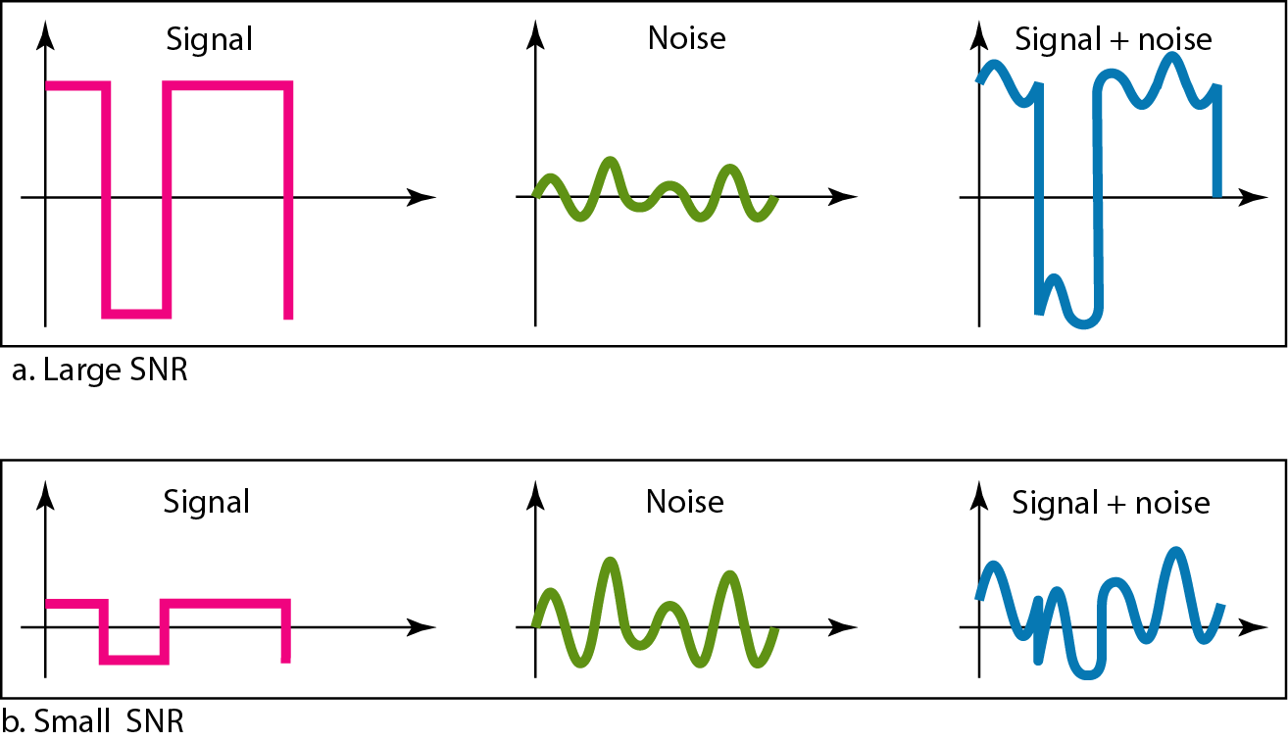
Figure 3.30 Two cases of SNR: a high SNR and a low SNR

Slide 51
3-5 DATA RATE LIMITS
A very important consideration in data communications is how fast we can send data, in bits per second, over a channel. Data rate depends on three factors:
1. The bandwidth available
2. The level of the signals we use
3. The quality of the channel (the level of noise)
Topics discussed in this section:
Noiseless Channel: Nyquist Bit Rate
Noisy Channel: Shannon Capacity
Using Both Limits

Slide 52
Note
Increasing the levels of a signal increases the probability of an error occurring, in other words it reduces the reliability of the system.

Slide 53
Capacity of a System
The bit rate of a system increases with an increase in the number of signal levels we use to denote a symbol.
A symbol can consist of a single bit or “n” bits.
The number of signal levels = 2^{n}.
As the number of levels goes up, the spacing between level decreases -> increasing the probability of an error occurring in the presence of transmission impairments.

Slide 54
Nyquist Theorem
Nyquist gives the upper bound for the bit rate of a transmission system by calculating the bit rate directly from the number of bits in a symbol (or signal levels) and the bandwidth of the system (assuming 2 symbols/per cycle and first harmonic).
Nyquist theorem states that for a noiseless channel:
C = 2 B log₂2^{n}
C= capacity in bps
B = bandwidth in Hz

Slide 55
Shannon’s Theorem
Shannon’s theorem gives the capacity of a system in the presence of noise.
C = B log₂(1 + SNR)
In this formula, bandwidth is the bandwidth of the channel,
SNR is the signal-to-noise ratio, and
capacity is the capacity of the channel in bits per second.

Slide 56
Note
The Shannon capacity gives us the upper limit; the Nyquist formula tells us how many signal levels we need.
Notes:
Note that in the Shannon formula there is no indication of the signal level, which means that no matter how many levels we have, we cannot achieve a data rate higher than the capacity of the channel. In other words, the formula defines a characteristic of the channel, not the method of transmission.

